Slide 1

Real estate project

Slide 2

Team Members
Frontend
(Smriti Rani , Usama Sukri)
Backend
(Rounak Bhadra , Darshan Marakall)
Devops
(Sagar Deshmukh , Kannappa Shivagond)

Slide 3

Technologies used
Java/Java Springboot
Project Workflow
AWS
GIT
Jenkins
Nexus
Docker
Ansible
Kubernetes
Mongo DB
Kafka
Swagger

Slide 4

Real Estate Property list app
Real estate property list is an app which helps its users to see and buy the houses online.
It gives all the details about the houses to the users and also allows them to contact to the admin team by using chatbot.
In this project we followed the Agile Product Delivery competency. The Agile Product Delivery competency is a customer-centric approach to defining, building, and releasing a continuous flow of valuable products and services to customers and users.

Slide 5
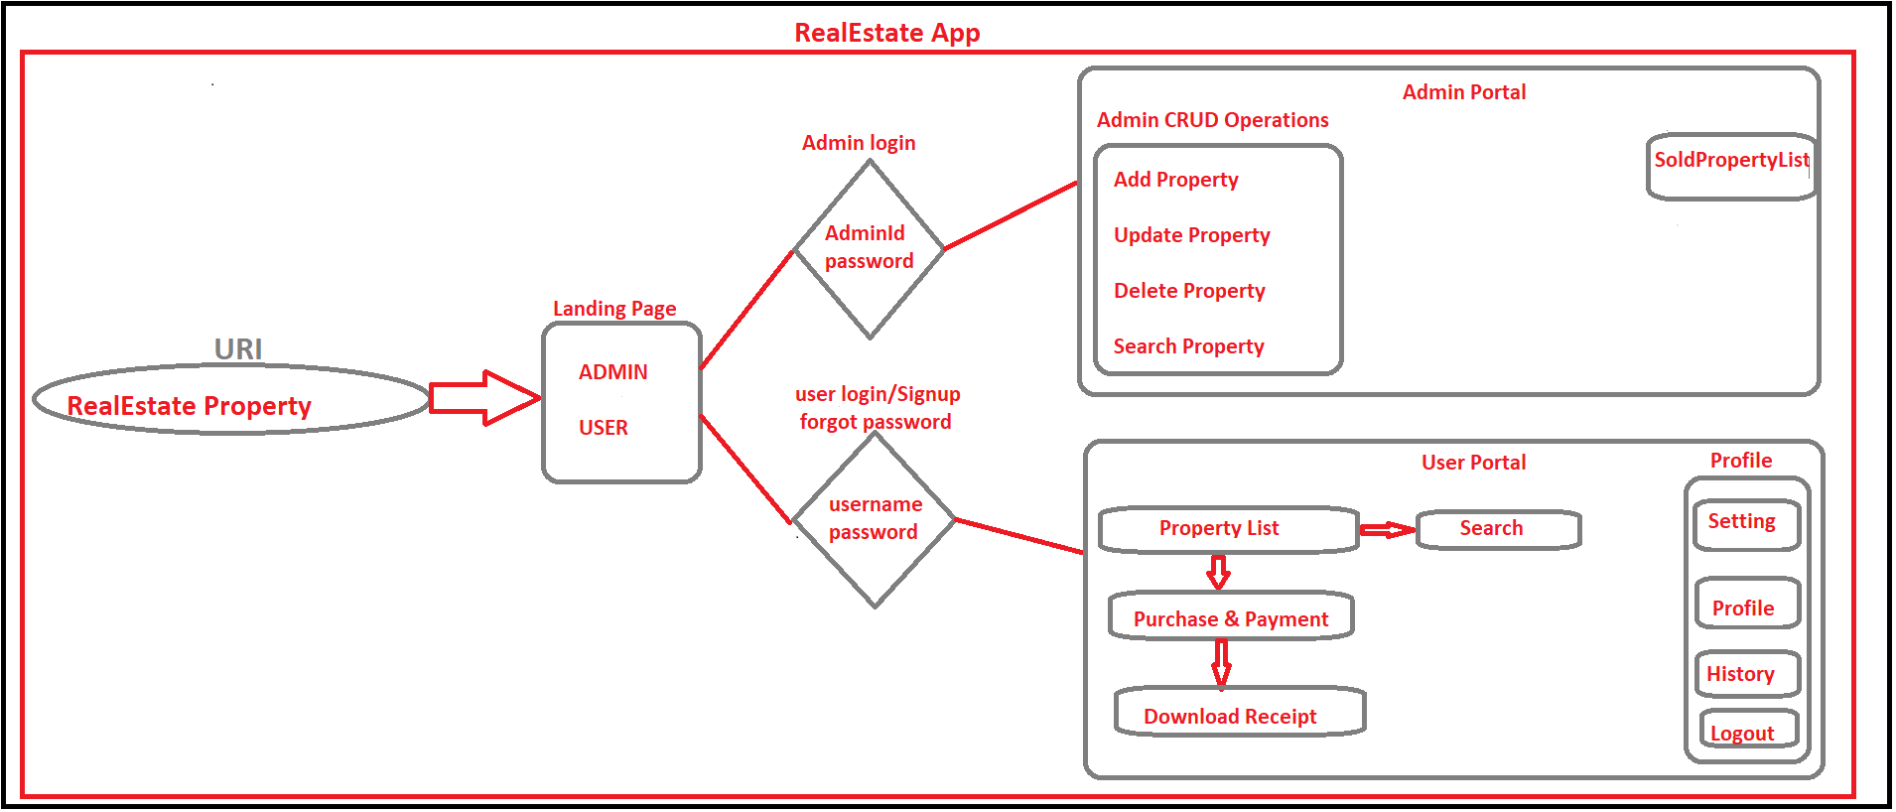
Project flowchart

Slide 6
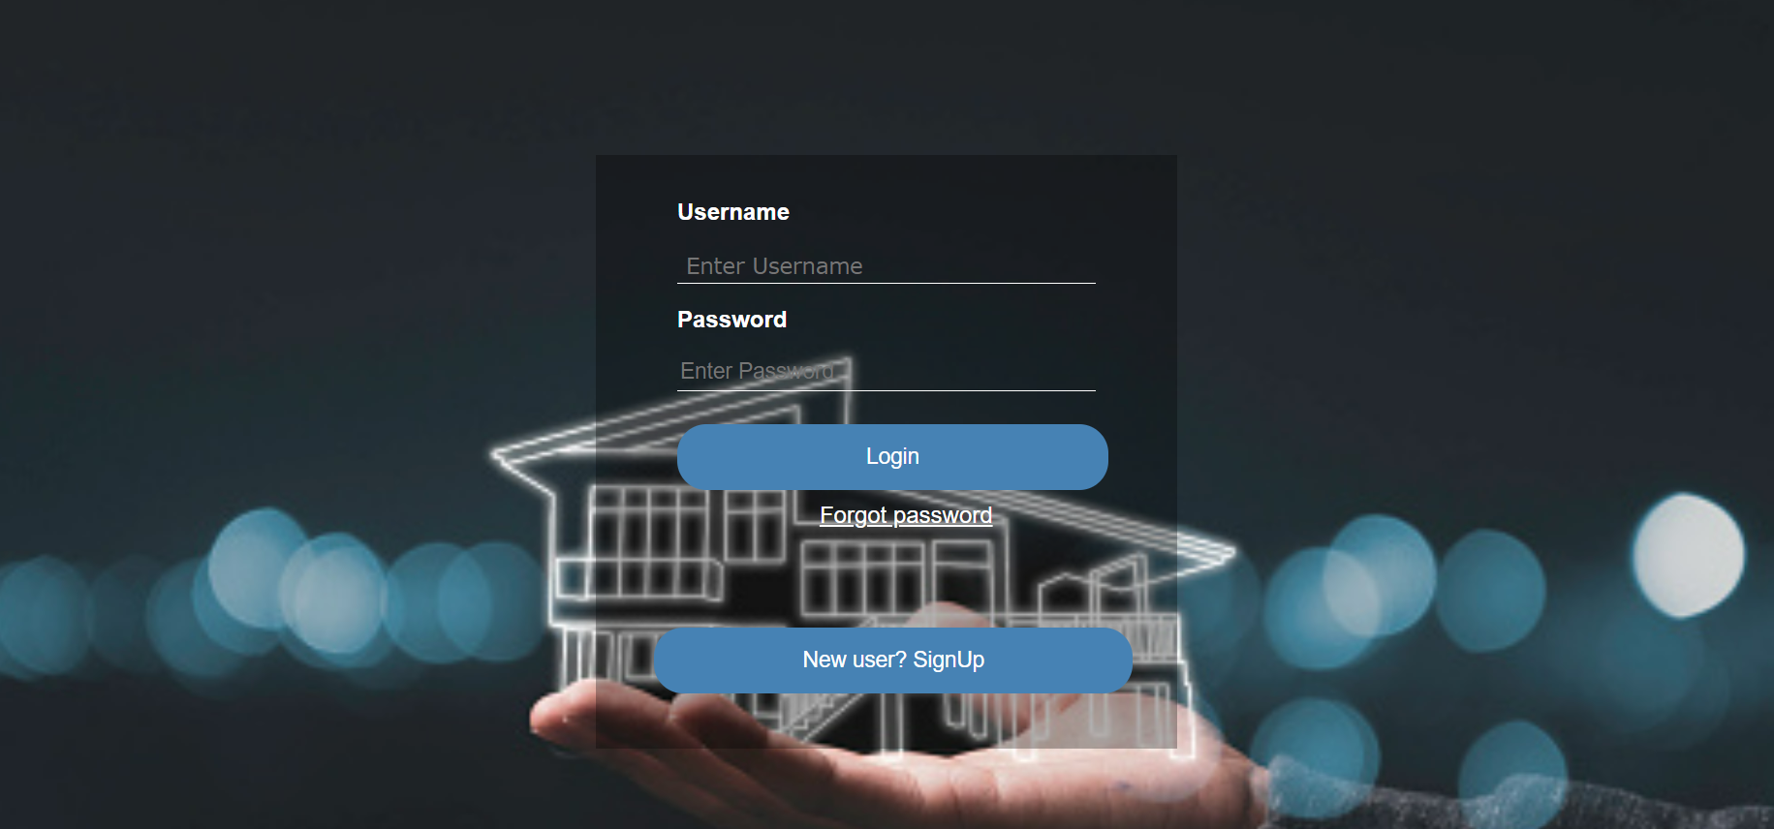
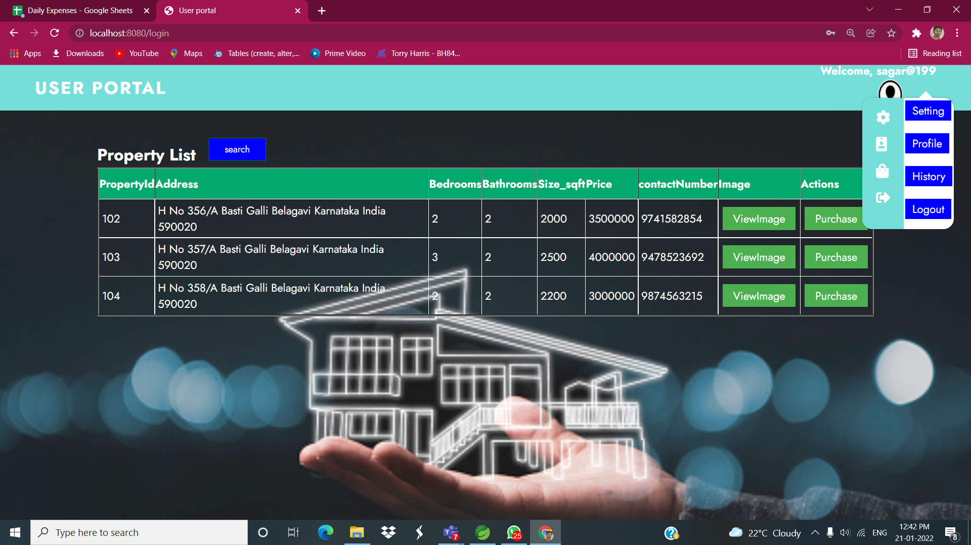

Slide 7
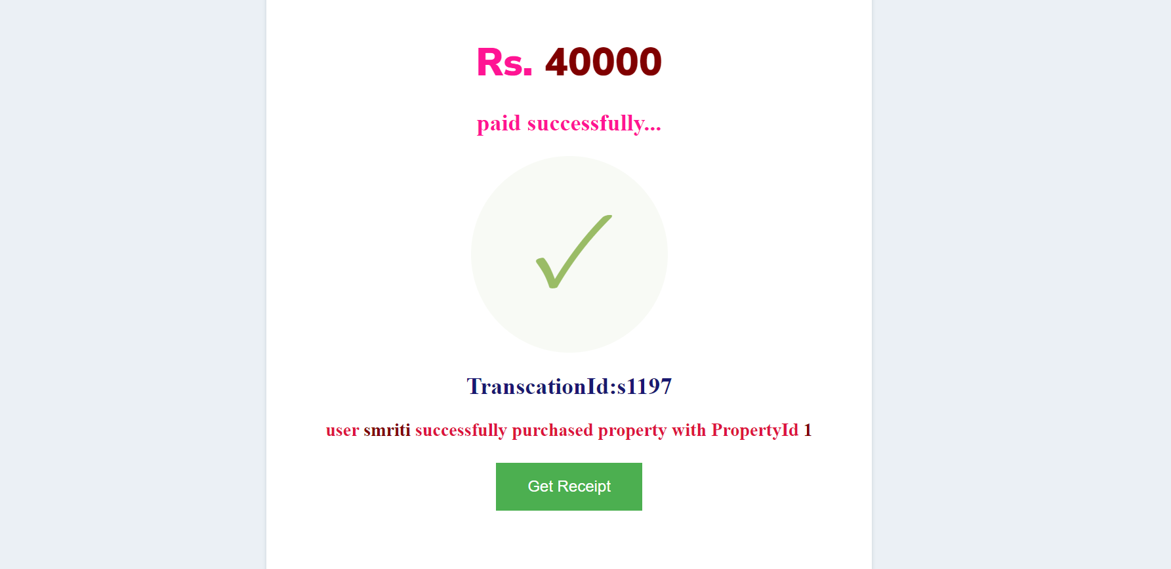
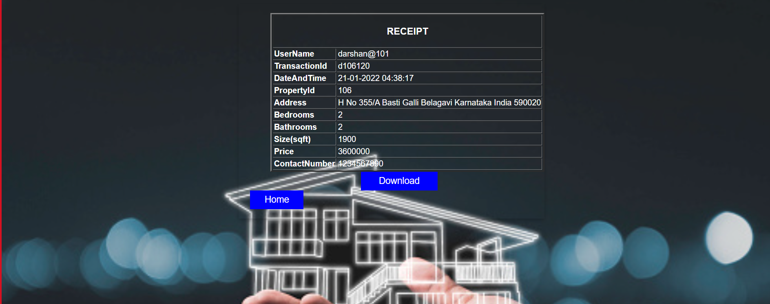
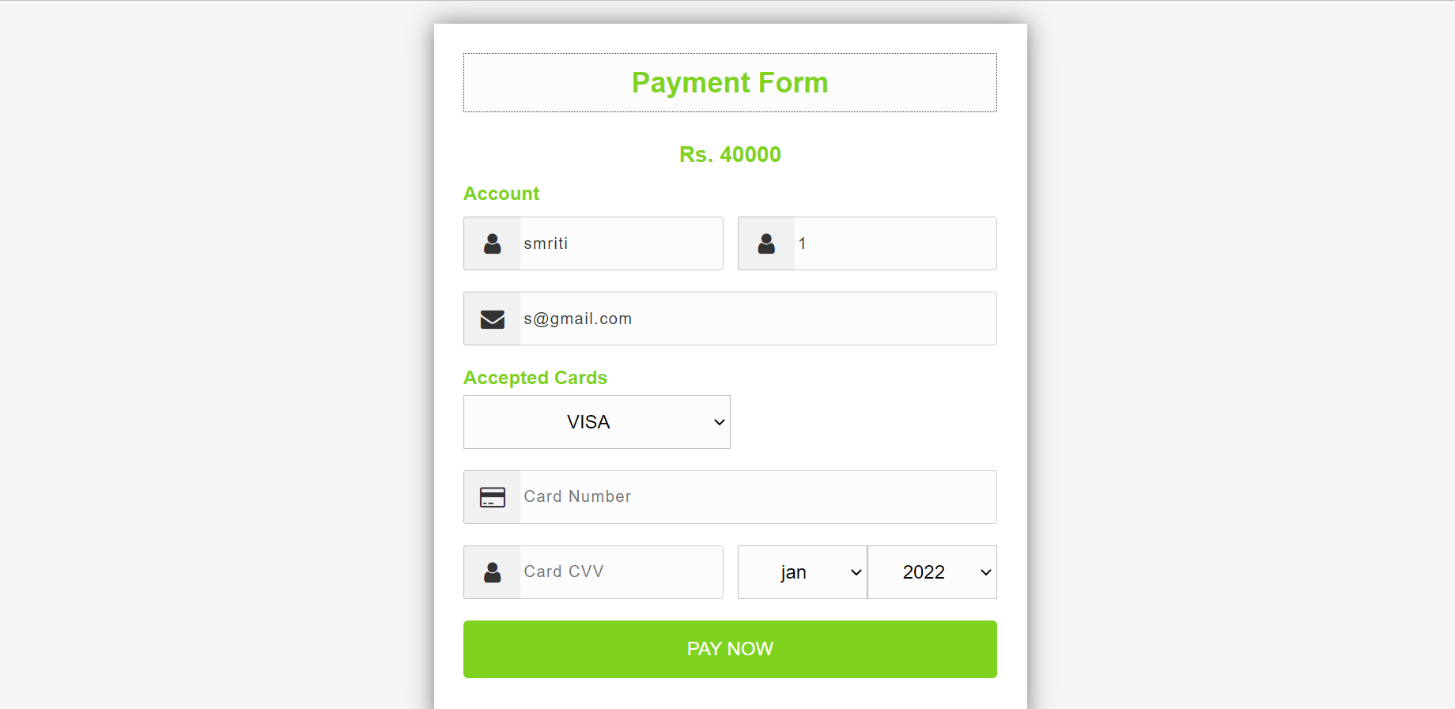

Slide 8
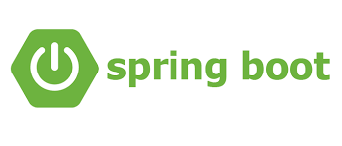
SPRING BOOT
Spring Boot is an open source Java-based framework used to create a micro Service. It is used to build stand-alone and production ready spring applications.
Micro Service is an architecture that allows the developers to develop and deploy services independently. Each service running has its own process and this achieves the lightweight model to support business applications.
Micro services offers the following advantages to its developers
Easy deployment
Simple scalability
Compatible with Containers
Minimum configuration
Lesser production time

Slide 9
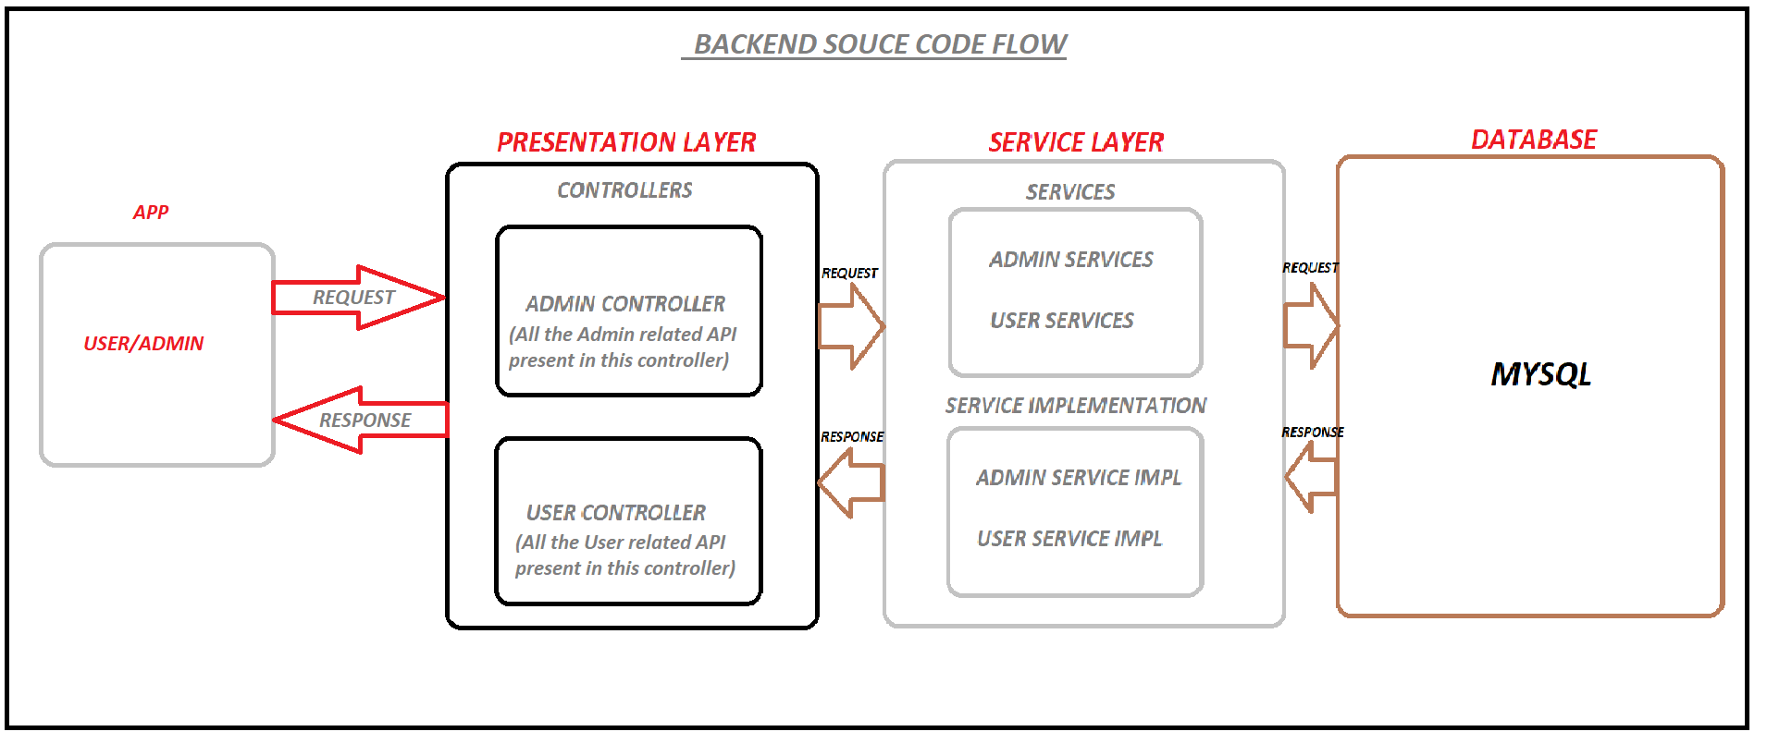

Slide 10
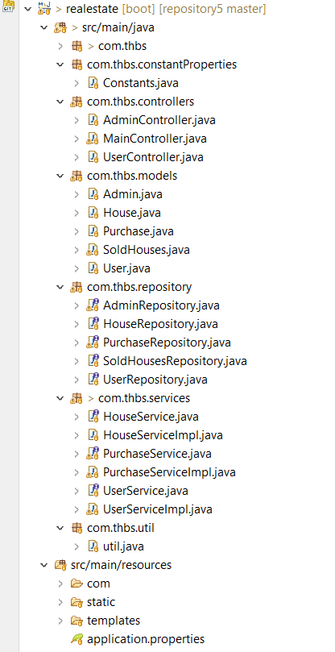
Spring Boot Project Tree

Slide 11
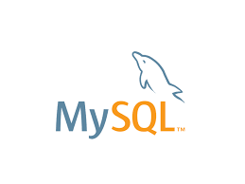
MYSQL
MySQL is a relational database management system (RDBMS) developed by Oracle that is based on structured query language (SQL).
A database is a structured collection of data. ... In this model, tables consist of rows and columns, and relationships between data elements all follow a strict logical structure.

Slide 12
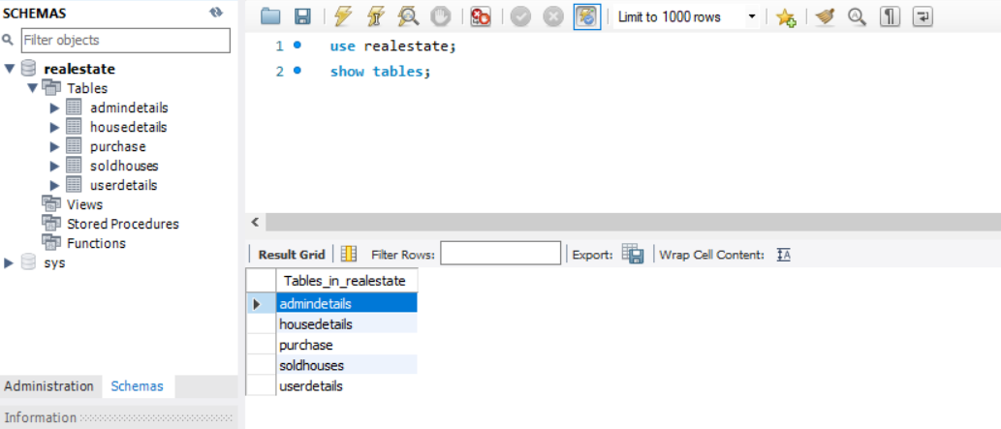
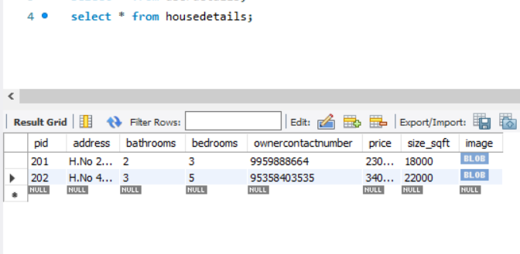
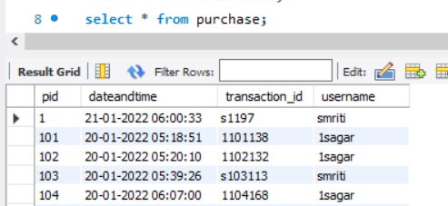
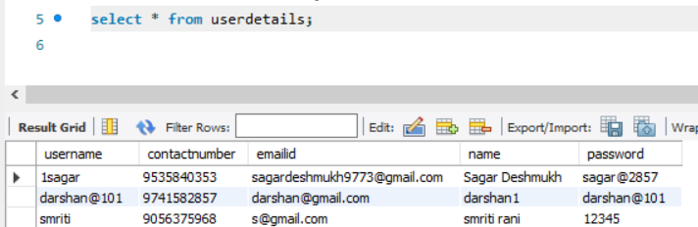
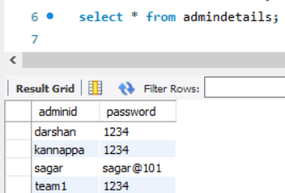
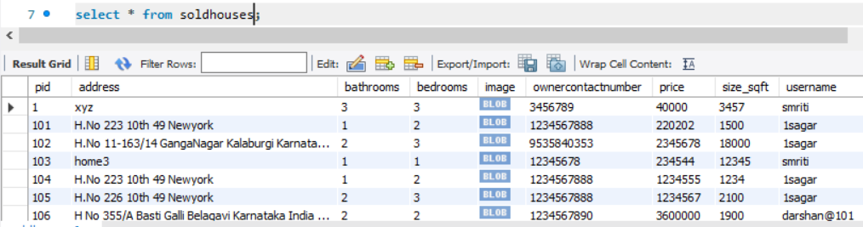

Slide 13
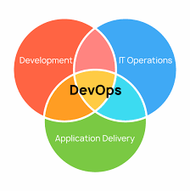
DEVOPS
DevOps is a set of practices that combines software development (Dev) and IT operations (Ops).
It aims to shorten the systems development life cycle and provide continuous delivery with high software quality.

Slide 14
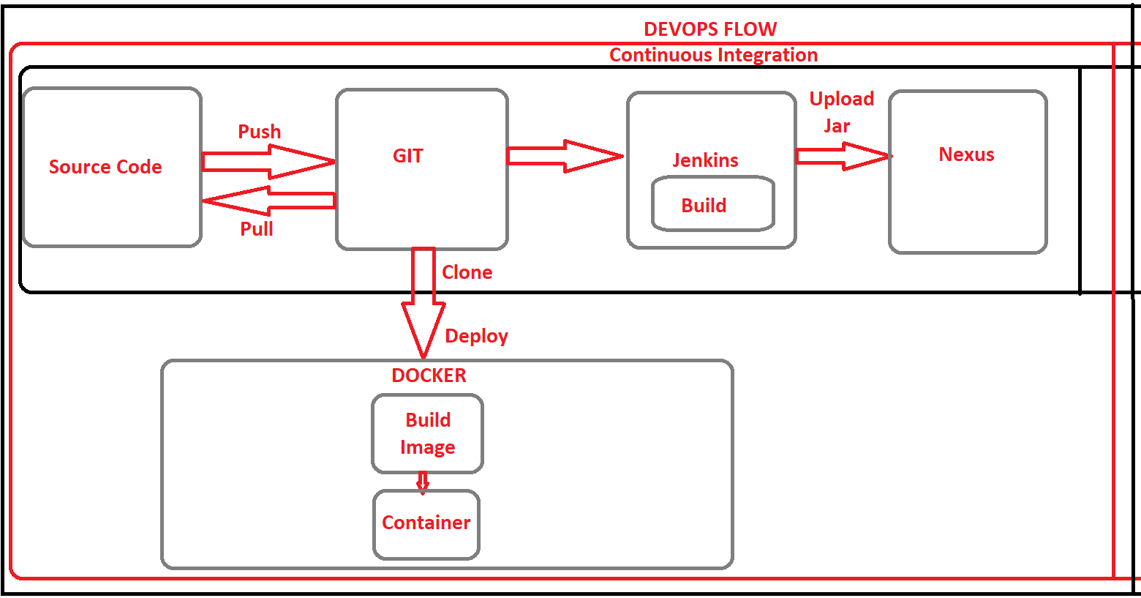
Devops flowchart

Slide 15

AMAZON WEB SERVICE
Amazon Web Services (AWS) is a secure cloud services platform, offering compute power, database storage, content delivery and other functionality to help businesses scale and grow.
In our project we used aws to create the instances, on which we performed the docker, Jenkins, nexus, ansible and Kubernetes operations

Slide 16
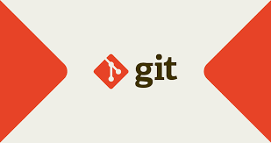
global information tracker
Git is software for tracking changes in any set of files, usually used for coordinating work among programmers collaboratively developing source code during software development.
In our project we used git for continuous integration where programmers can push and pull the source code.
We connected the git with jenkins which triggers automatically build operation in jenkins.

Slide 17
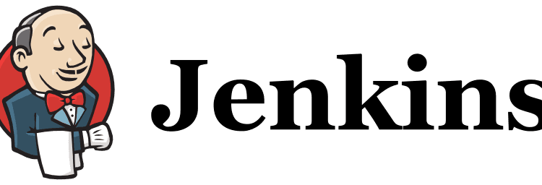
Jenkins
Jenkins is a tool that is used for automation, and it is an open-source server that allows all the developers to build, test and deploy software.
In short we can say that Jenkins is an continuous integration tool using which developing and testing process occurs side by side to avoid late in the project deployment.
We connected the Jenkins with the git and nexus.

Slide 18
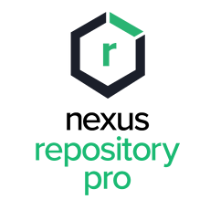
NeXUS
Nexus is a repository manager. It allows you to proxy, collect, and manage your dependencies so that you are not constantly juggling a collection of JARs
Whenever the project builds in the nexus the new jar version is get create inside the nexus
We can say that nexus can be used internally so that the upcoming developers who works on same project get the jar/dependencies of older version.

Slide 19
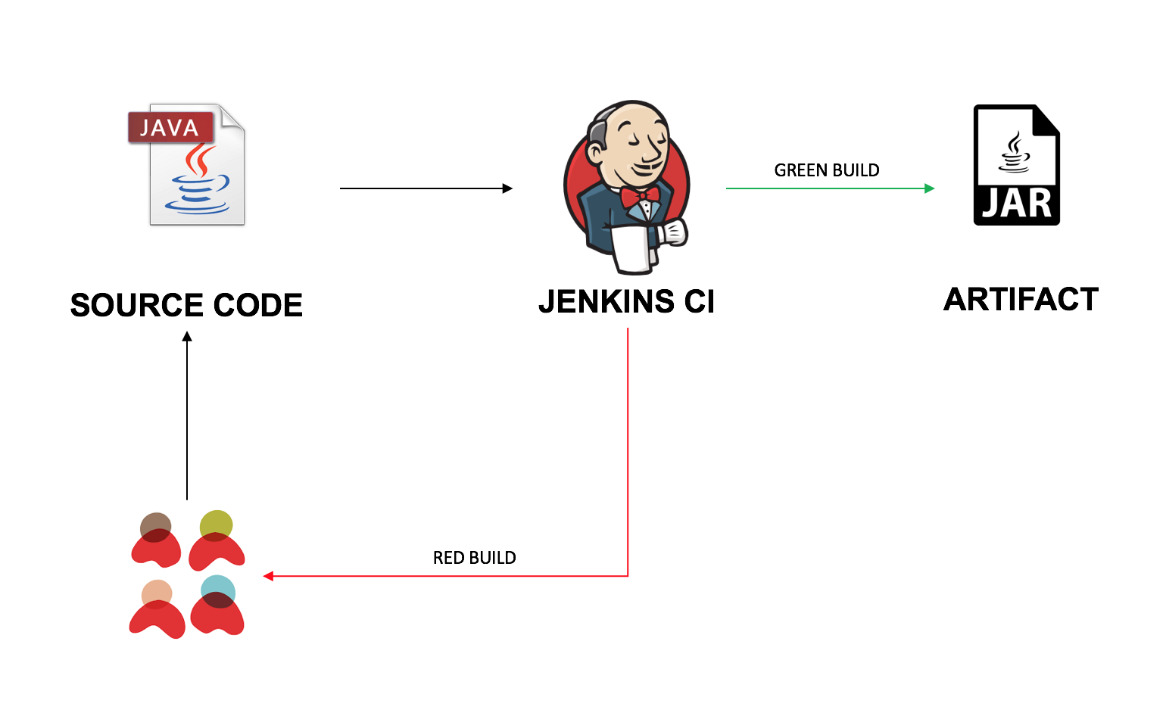
Architecture of Artifact Generation

Slide 20
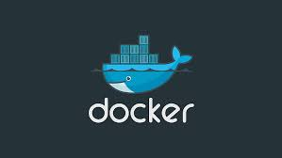
DoCKER
Docker is a software platform that use OS-level virtualization to deliver software in packages called containers.
We built the image of our project using jar file and side by side containers are also created when we run the image
We have uploaded the docker image to Docker hub.

Slide 21
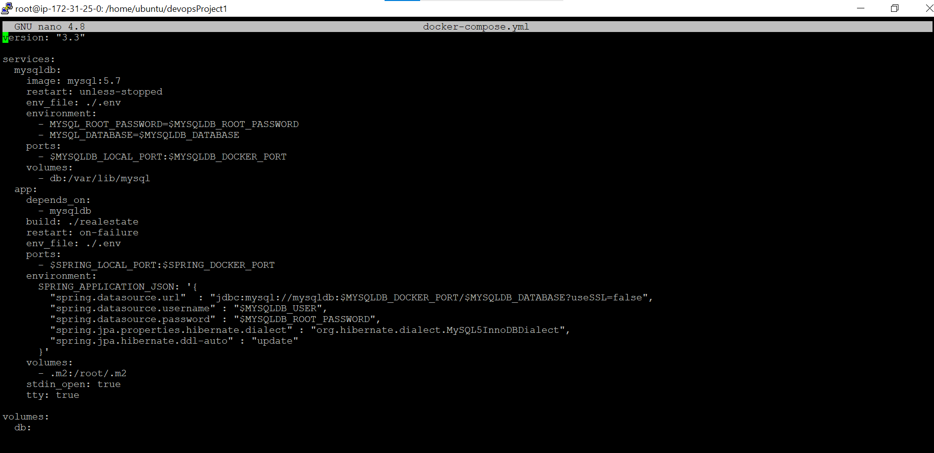
docker-compose file (.yaml)

Slide 22
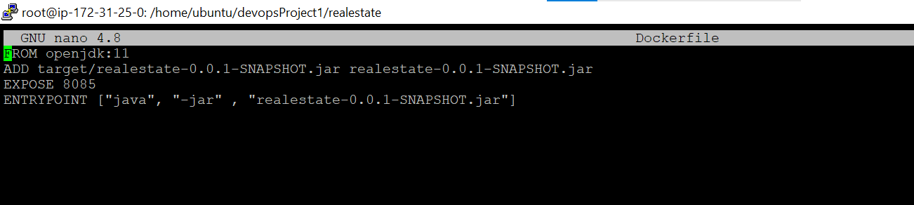
Docker file

Slide 23
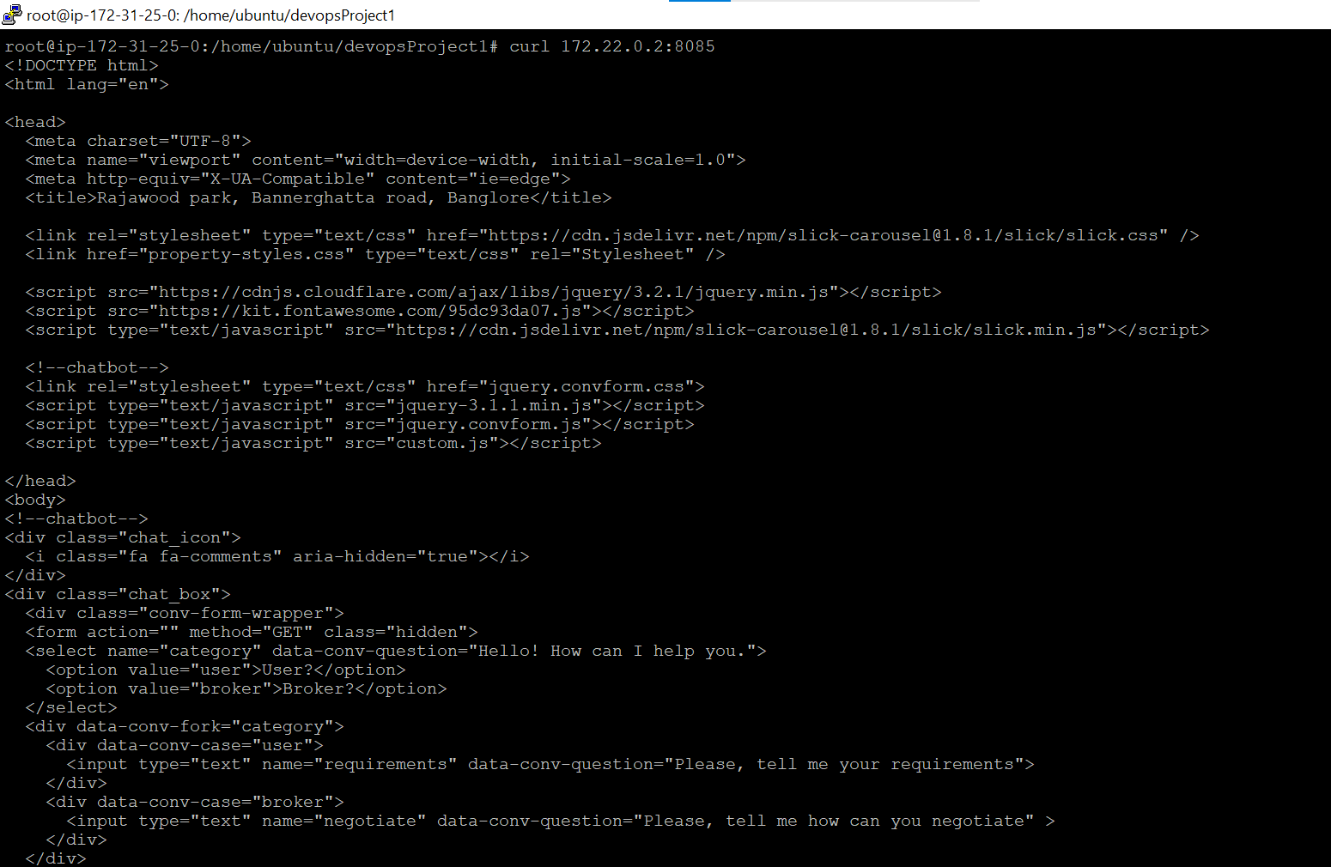
Html code of Home page using curl command

Slide 24
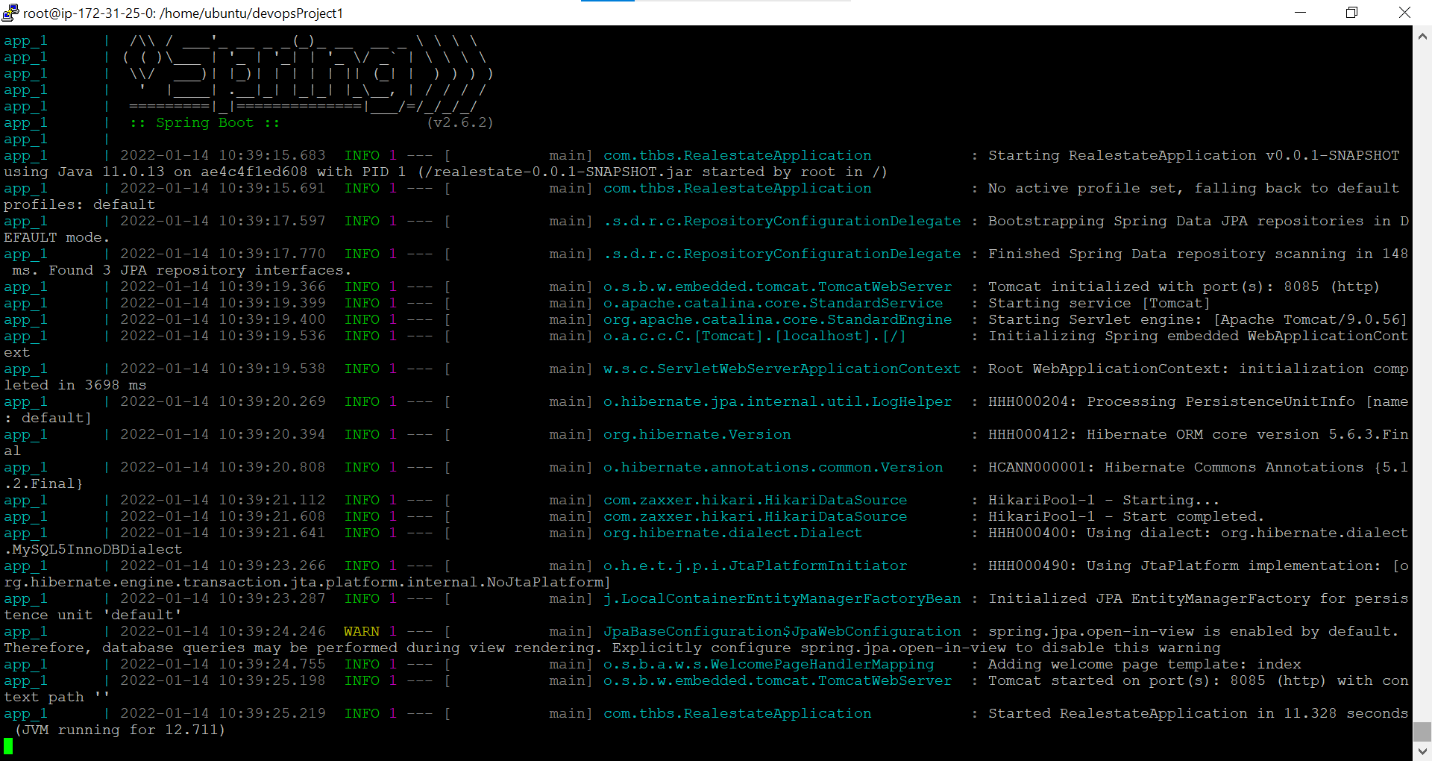
Spring boot application running inside the docker container

Slide 25
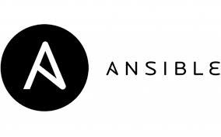
ANSIBLE
Ansible is an open sourceIT automation tool that automates provisioning, configuration management, application deployment, orchestration, and many other manual IT processes
We created one server node and two worker nodes and connected them using ansible.
We can deploy any package over workers by simply executing the playbooks
Playbooks are one of the core features of Ansible and tell Ansible what to execute. They are like a to-do list for Ansible that contains a list of tasks.

Slide 26
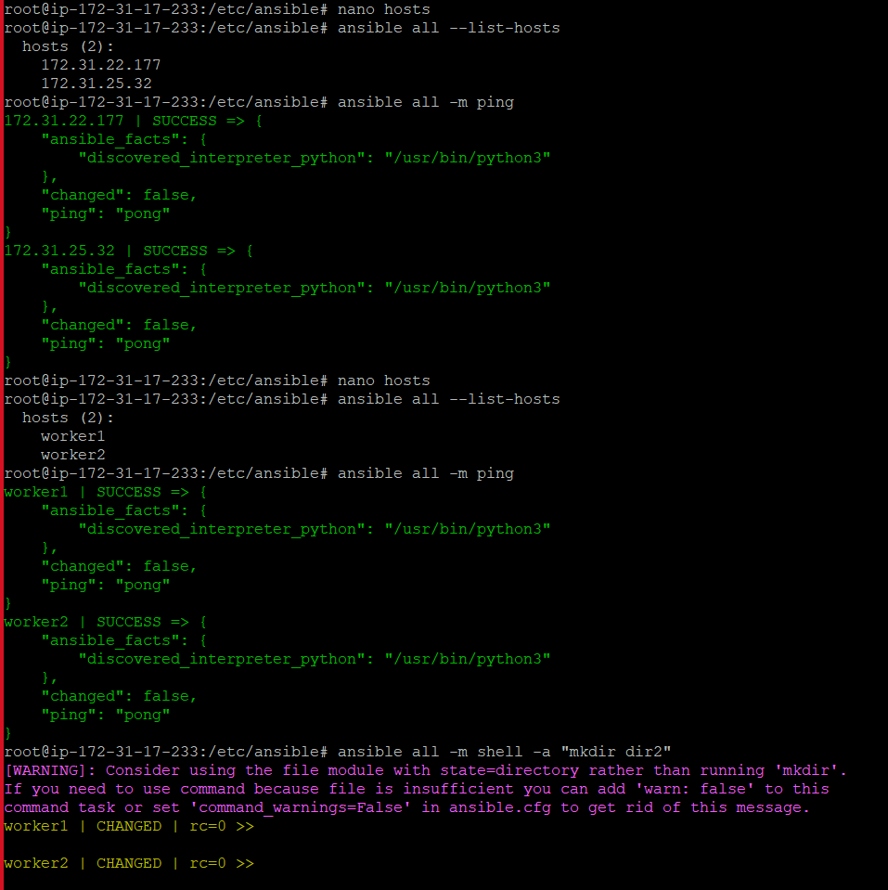
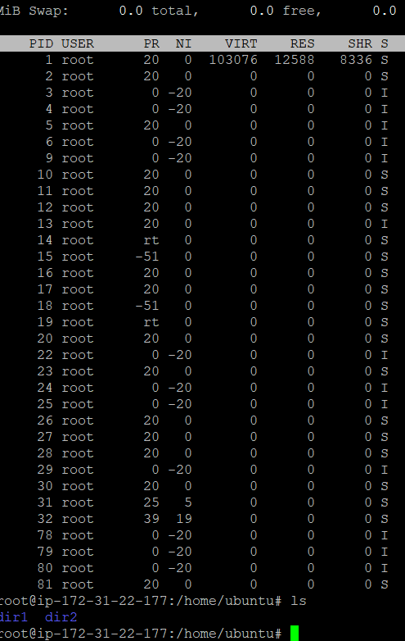
Worker node is successfully connected with master node using ansible

Slide 27
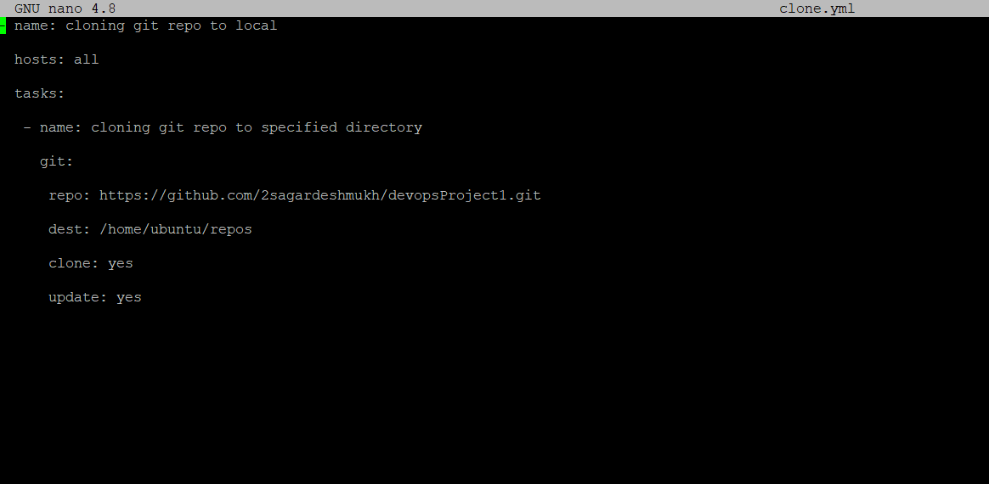
Cloning of a git repo using ansible playbook

Slide 28
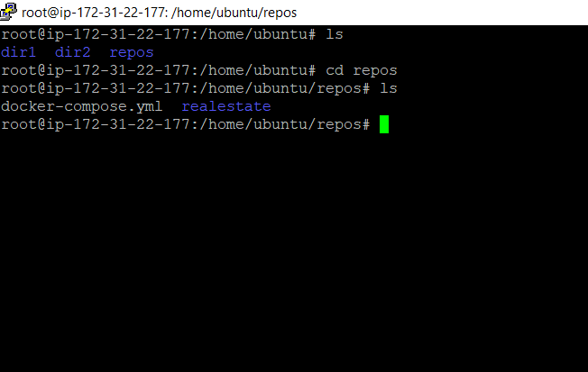
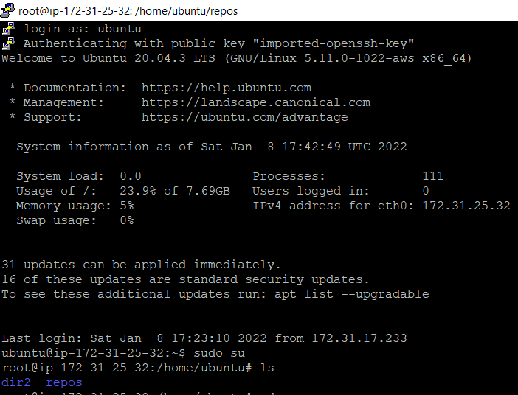
Worker nodes after cloning git repo

Slide 29
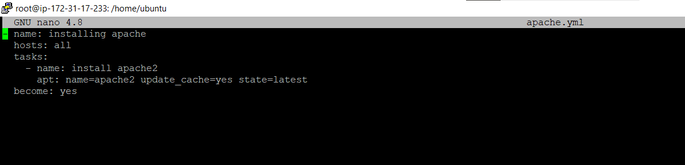
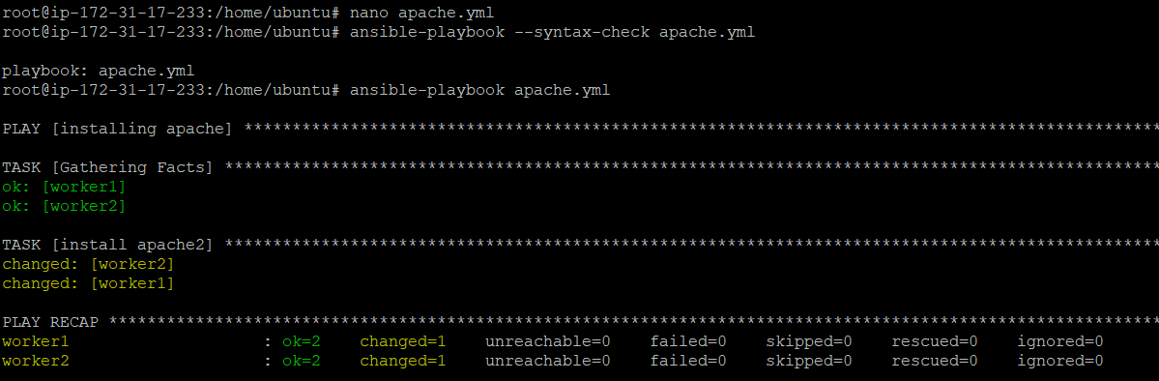
Installed apache2 using ansible playbook

Slide 30
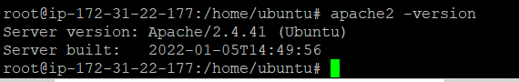
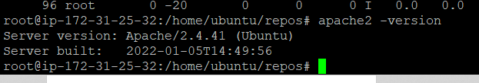
Worker nodes after installing apache using playbook

Slide 31
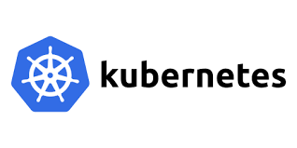
KUBERNETES
Kubernetes is a portable, extensible, open-source platform for managing containerized workloads and services, that facilitates both declarative configuration and automation.
We connected a worker node with master node as a standalone application
We created the pods using pod file which is in yaml format.

Slide 32
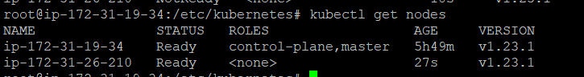
Worker node is successfully connected with Master node

Slide 33
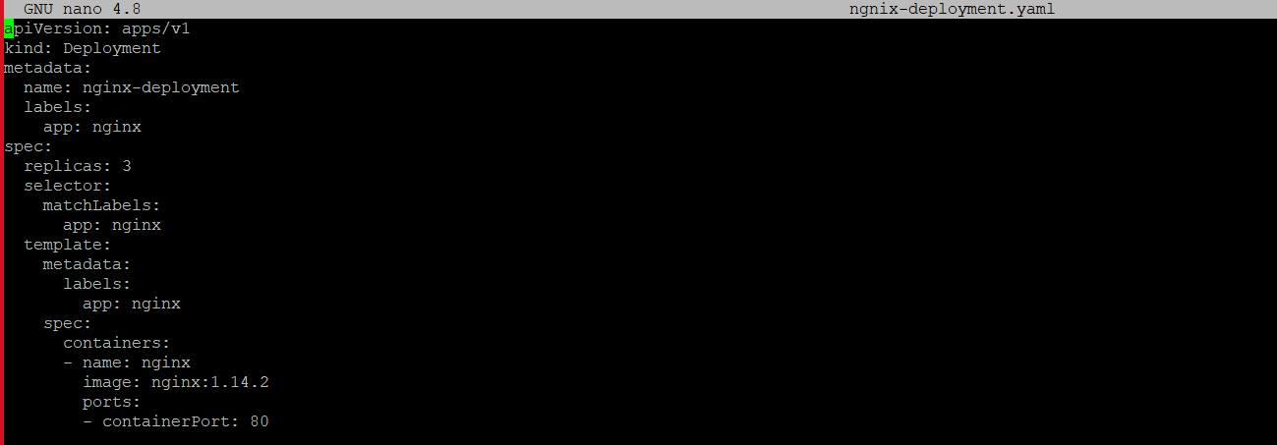
Creating pod file named ngnix-deployment.yaml in which ngnix app is installed and number of replicas given as 3.

Slide 34
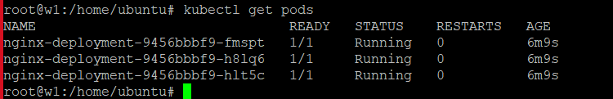
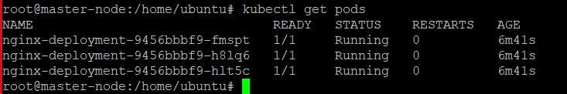
Running pods in master node
Above image shows the pods are up and running in the worker node.

Slide 35
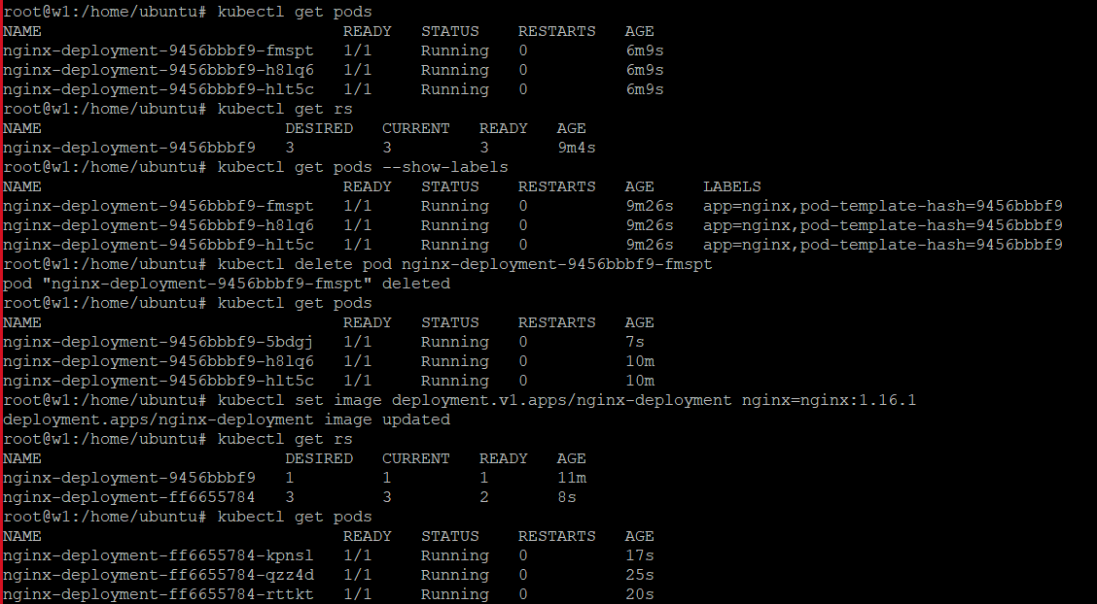
Pod Operations: Deletion and updation of the pods

Slide 36
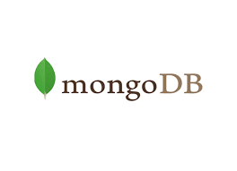
MONGODB
MongoDB is an open-source document-oriented database that is designed to store a large scale of data.
It is categorized under the NoSQL (Not only SQL) database because the storage and retrieval of data in the MongoDB are not in the form of tables.
We creates the NoSQL mongodb database which is replica of our real estate project SQL database.

Slide 37
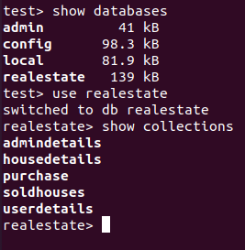
Created a database in Mongodb as "realestate" and collections as:
admindetails
housedetails
purchase
soldhouses
userdetails

Slide 38
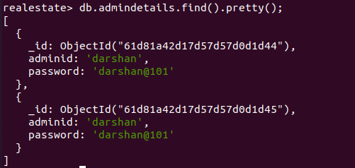
admindetails

Slide 39
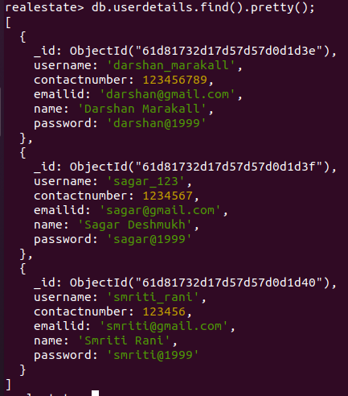
userdetails

Slide 40
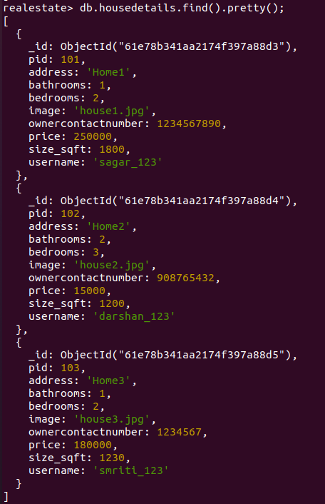
housedetails

Slide 41
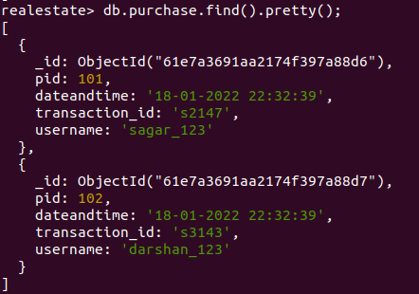
purchase

Slide 42
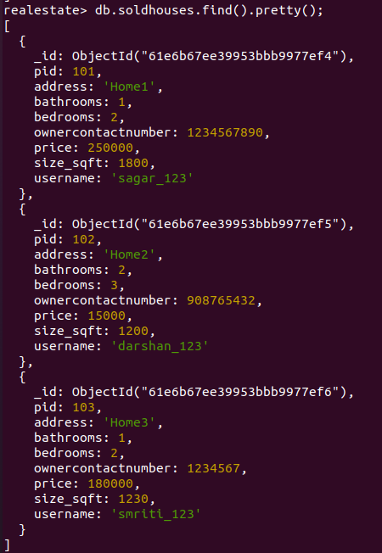
soldhouses

Slide 43

KAFKA
Kafka is a distributed system consisting of servers and clients that communicate via a high-performance TCP network protocol .
Basically it is a distributed publish-subscribe messaging system that receives data from disparate source systems and makes the data available to target systems in real time.
Here we used single node single cluster which means we connected single server with single node.
What message we give in producer that we can see in consumer

Slide 44

Below image shows what message we produce that we can see in consumer

Slide 45

SWAGGER
Swagger is an Interface Description Language for describing RESTful APIs expressed using JSON.
Swagger is used together with a set of open-source software tools to design, build, document, and use RESTful web services.
Swagger includes automated documentation, code generation, and test-case generation.

Slide 46



Slide 47




SwaggerHub offers common design models which can be saved in dedicated stores called domains & can be referenced & reused across the code.

Slide 48

Thank You

